Slide 1



CONCEPT TO PRACTICE
GROUP ID: 54646657

Slide 2
OUR TEAM
MEMBER
PROJECT TITLE
GUIDE NAME
Faldu Jaimin
lost and found portal
Krina masharu
ER. NO.
15110623006
2025-26

Slide 3
INDEX OF CONTENT
•INTRODUCTION
•PROBLEM STATEMENT
•PROPOSED SYSTEM
•TOOLS & TECHNOLOGIES
•RESULTS
•FUTURE SCOPE
•CONCLUSION

Slide 4
Introduction
PROJECT BACKGROUND AND RELEVANCE
The Lost & Found Portal addresses the challenges of misplaced items in educational settings, improving recovery rates and reducing informal tracking methods.

Slide 5
Problem Statement
CURRENT SYSTEM LIMITATIONS
ISSUES / LIMITATIONS
Manual reporting.
No structured database.
No verification process.
Fake claims possible.
No tracking history.
No centralized access.
No analytics for administration
NEED FOR IMPROVEMENT
Secure digital platform.
AI-based verification.
Automated matching system.
Tamper-proof records.

Slide 6
Proposed System
OVERVIEW OF PROPOSED SOLUTION
KEY FEATURES
Web-based Lost & Found Portal.
Role-based access (Student, Admin, HOD).
AI-powered image verification.
Lost/Found item reporting.
YOLO + CLIP + OCR verification.
Smart match detection.
Notification system.
Admin dashboard with analytics.
Multilingual support (EN/HI/GU).
HOW IT SOLVES THE PROBLEM
Prevents fake item claims.
Automates match detection.
Provides tamper-proof record storage.
Improves transparency and efficiency.

Slide 7
Tools & Technologies
PROGRAMMING LANGUAGE (FRONT END)
TOOLS / SOFTWARE
HTML
CSS
JavaScript
Bootstrap
Flask-SQLAlchemy
SQLite / PostgreSQL
YOLOv8
OpenAI CLIP
EasyOCR
ReportLab
Flask-Babel
Custom Blockchain Module
PROGRAMMING LANGUAGE (BACK END)
Python 3.10
Flask Framework

Slide 8
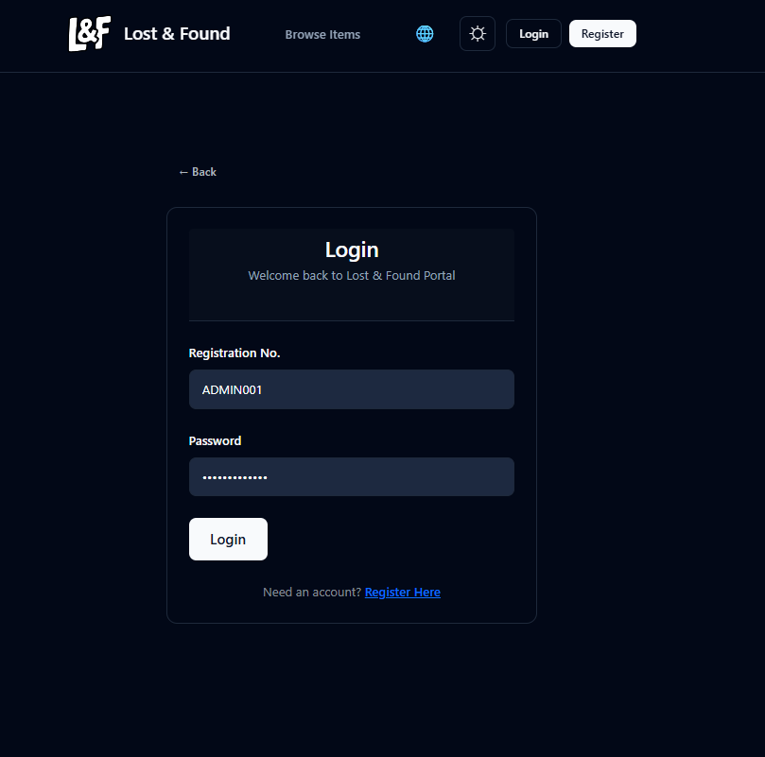
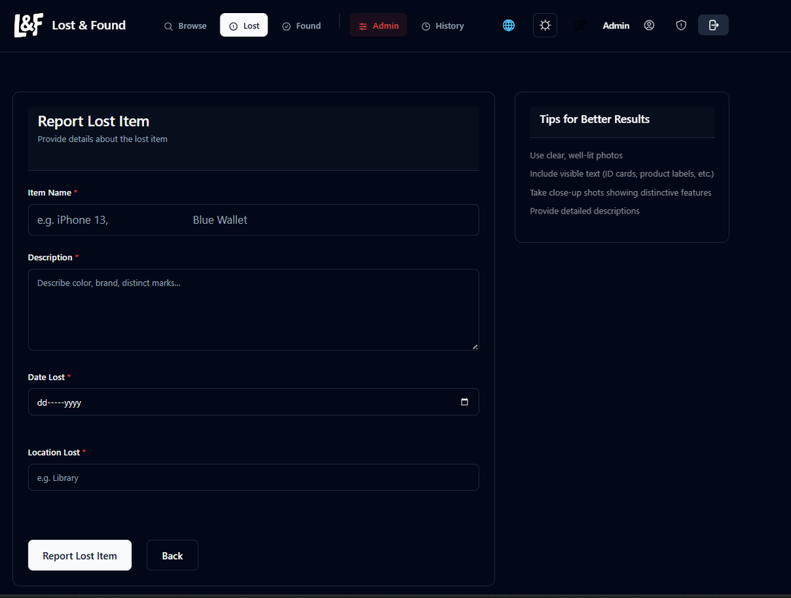
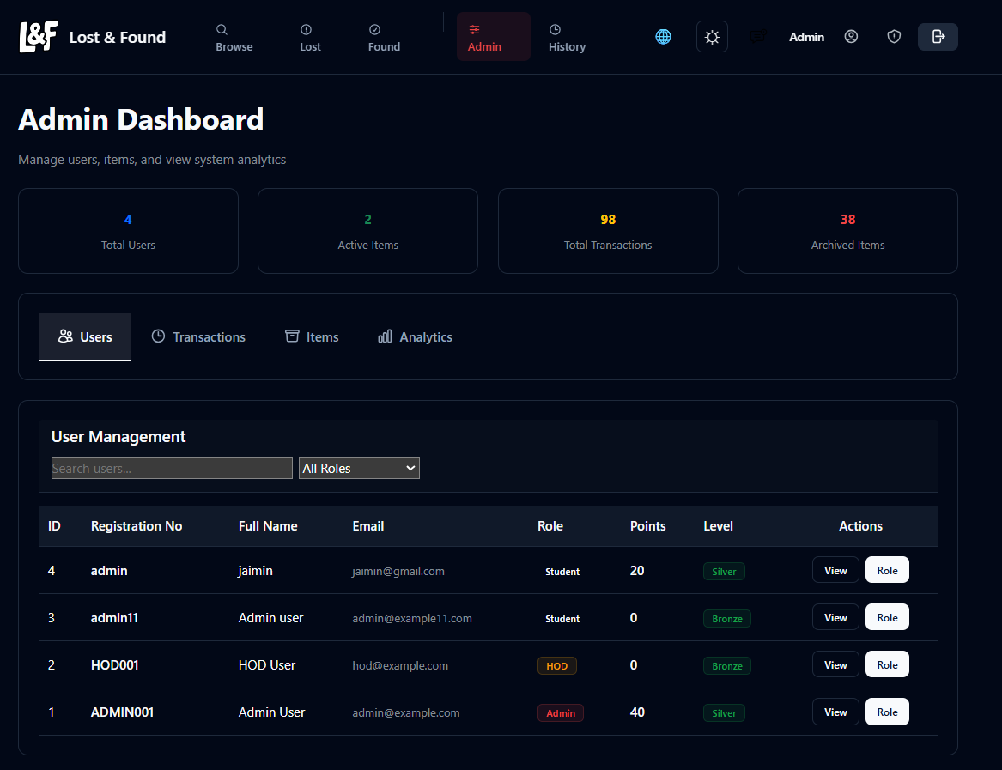
Visual Demonstration of Portal Output
USER LOGIN
REPORT ITEM
ADMIN DASHBOARD
Simple access for returning users.
Easy way to report lost items.
Comprehensive overview of portal activity.

Slide 9
result
PERFORMANCE METRICS
AI verification using 3 models
Secure Argon2 password hashing
Handles 5000+ users (scalable design)
Image size limit: 2MB

Slide 10
FUTURE SCOPE
ENHANCEMENTS
FUTURE RESEARCH DIRECTIONS
Email & SMS alerts
Mobile app (React Native / Flutter)
Face recognition for ID cards
Improved AI accuracy
Advanced fraud detection
Integration with CCTV systems
SCALABILITY
Cloud deployment (AWS / Render)
PostgreSQL production migration
Multi-institution SaaS model

Slide 11
Conclusion
The Lost & Found Portal is a full-stack web application designed to digitize and secure the lost-and-found process in educational institutions. It integrates AI-based image verification, smart matching algorithms, blockchain-based tamper-proof records, and multilingual support.
The system enhances transparency, reduces fake claims, improves recovery time, and provides powerful analytics for administration.
With scalability and future upgrade possibilities, the portal can be deployed in any institution as a secure and intelligent solution.

Slide 12


Thank You for Your Attention

